Slide 1
Module 1.3 – Course Introduction
Introduction to Jetson TX1/TK1 and Toolkit

Slide 2
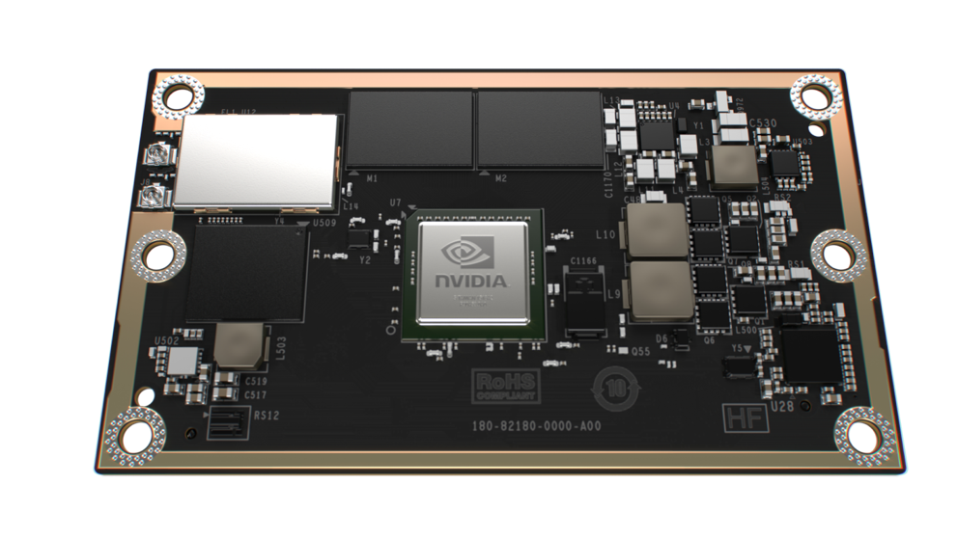
 | Jetson TX1
GPU | 1 TFLOP/s 256-core Maxwell
CPU | 4x 64-bit ARM A57 CPUs
Memory | 4 GB LPDDR4 | 25.6 GB/s
Video decode | 4K 60Hz H.264
Video encode | 4K 30Hz H.264
CSI | Up to 6 cameras | 1400 Mpix/s
Display | 2x DSI, 1x eDP 1.4, 1x DP 1.2/HDMI
Wi-Fi | 802.11 2x2 ac
Networking | 1 Gigabit Ethernet
PCI-E | Gen 2 1x1 + 1x4
Storage | 16 GB eMMC, SDIO, SATA
Other | 3x UART, 3x SPI, 4x I2C, 4x I2S, GPIOs
Power | 5-10 Watts, 6.6V-19.5VDC (Sub-5 Possible)
Size | 50mm x 87mm
Jetson TX1
Notes:
With 256 CUDA-enabled Maxwell cores and over a teraflop of raw compute in only 10-15 watts power consumption, Jetson TX1 provides the ultimate in embedded performance and efficiency.
It has 64 bit ARM CPUs, 4 GB of LPDDR4 memory with bandwidth up to 25.6 GB/s. 16 GB of Flash storage, WiFi and bluetooth ready. Gigabit Ethernet. It’s 50mm x 87mm, slightly smaller in area than a credit card (obviously it’s bigger in the Z dimension). It interfaces with a carrier board over a 400 pin board to board connector, which brings out all of the high-speed and general purpose signals from the chip. Our customers will take Jetson TX1 and integrate it into their final products that have the exact form factor and interfaces that they need. We also provide a developer kit, which I’m going to talk about later.

Slide 3
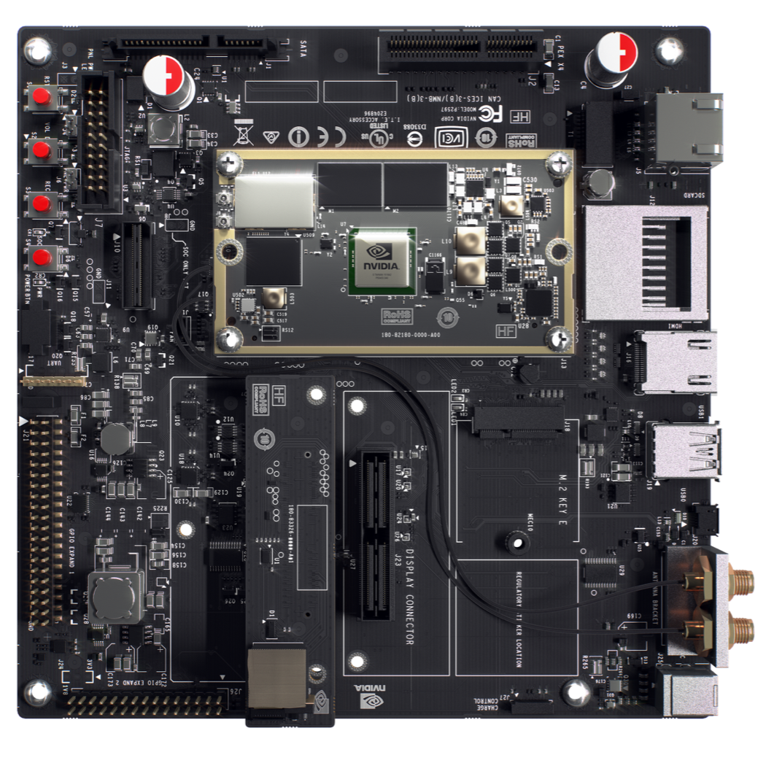
Jetson TX1 Developer Kit
Jetson TX1
Developer Board
5MP Camera
Notes:
So how do you get started with the Jetson TX1? This is the Jetson TX1 Developer Kit. It includes the Jetson TX1, a carrier board to break out all of the I/O, and a 5 MP camera. This is the system that developers will use to get started with Jetson TX1. Then when they’re ready to build their final product, they purchase individual Jetson TX1 modules, and build their custom solution around it. The Jetson TX1 developer kit is also a reference design for those custom solutions. If you’re familiar with the Jetson TK1 developer kit, this is very similar in capabilites. I’ll highlight the differences. First, as I’ve been saying, we built a module. For the previous generation a developer would start with the Jetson TK1 Developer Kit for development, and for production of their product they would by Tegra chips. For Jetson TX1, they start with the Jetson TX1 developer kit, and for production of their product they buy jetson TX1 modules. We did this to simplify things. All of the hard things to develop in a system like power sequencing and laying out memory. It doesn’t make sense for every customer to have to repeat that exercise. So why not encapluate it on a module? Second difference is performance. Going from Jetson TK1 to TX1 anywhere from a 2x – 3x speedup, depending on the application. Finally, we listened to the feedback we saw from the community and added WiFi and Bluetooth, added a CSI camera, and made the general purpose I/O easier to use by adding a way to set it to 3.3V, and including more. There’s also a x4 Gen2 PCIe slot. Besides those things, it’s largely similar to the Jetson TK1 devkit.

Slide 4
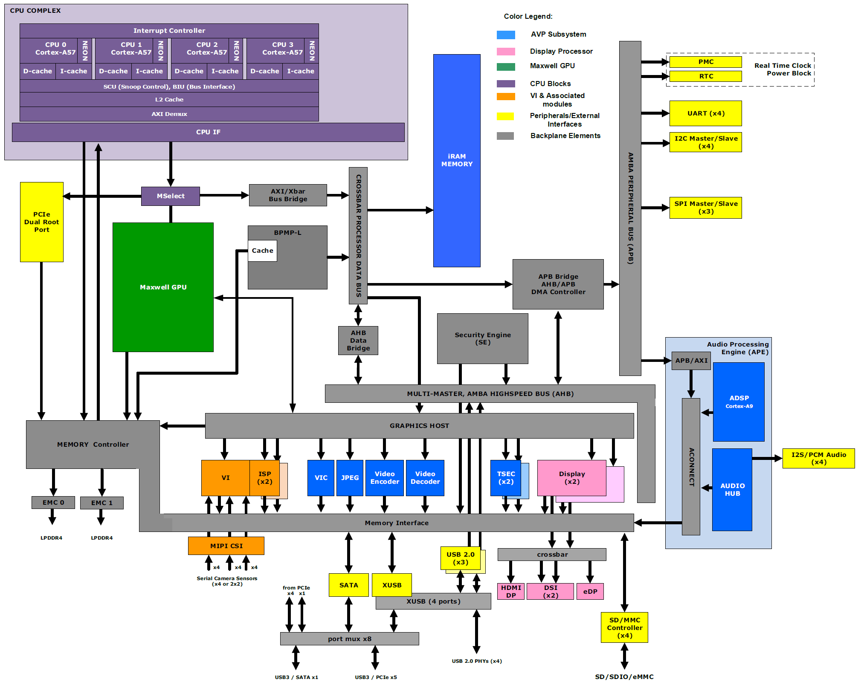
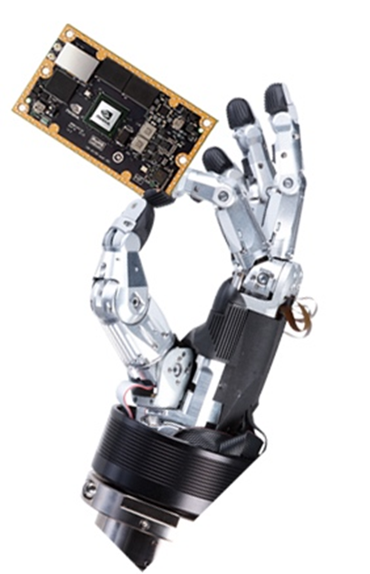
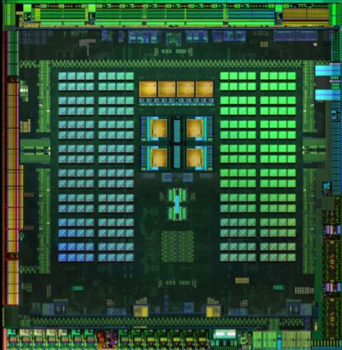
JETSON TX1 — BLOCK DIAGRAM
—
Schematics, Layouts
—
Notes:
Here’s a high-level block diagram of the Tegra X1 SoC. The Jetson module’s pinout very closely mimics the TX1’s capabilities. The complexity of modern-day system-on-chips exceeds that of a Saturn V rocket. It’s a true embedded system. There are so many functional units operating asynchronously within a chip half the size of a postage stamp, that when the software layers are added in, it reaches almost bewildering complexity.
The important bit is the CUDA engine, which allows users to easily harness the full 1024 GFLOPS of performance for general-purpose GPU applications like high-bandwidth video, image, and signal processing, complex maths, and DSP.

Slide 5
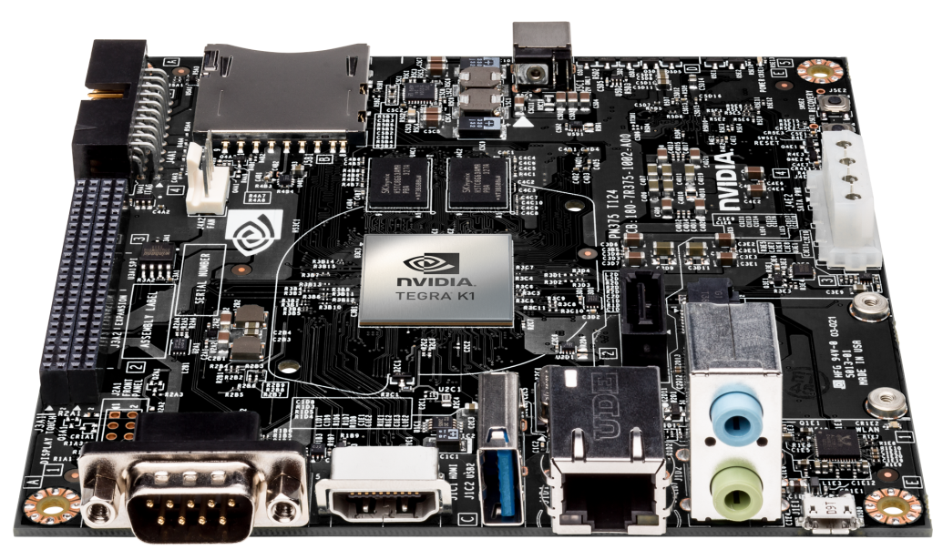
Jetson TK1
The world’s first embedded supercomputer
Tegra K1 Development Kit
Run Ubuntu Linux
CUDA
OpenCV optimized for Tegra
Notes:
The Jetson TK1 is the primary ‘brain’ of Jet and will be the primary computing platform for this robotics course
The board run Ubuntu Linux, so if you are familiar with using Linux, the environment will be very familiar
The board has 2GB of RAM and 16GB of built in flash memory

Slide 6
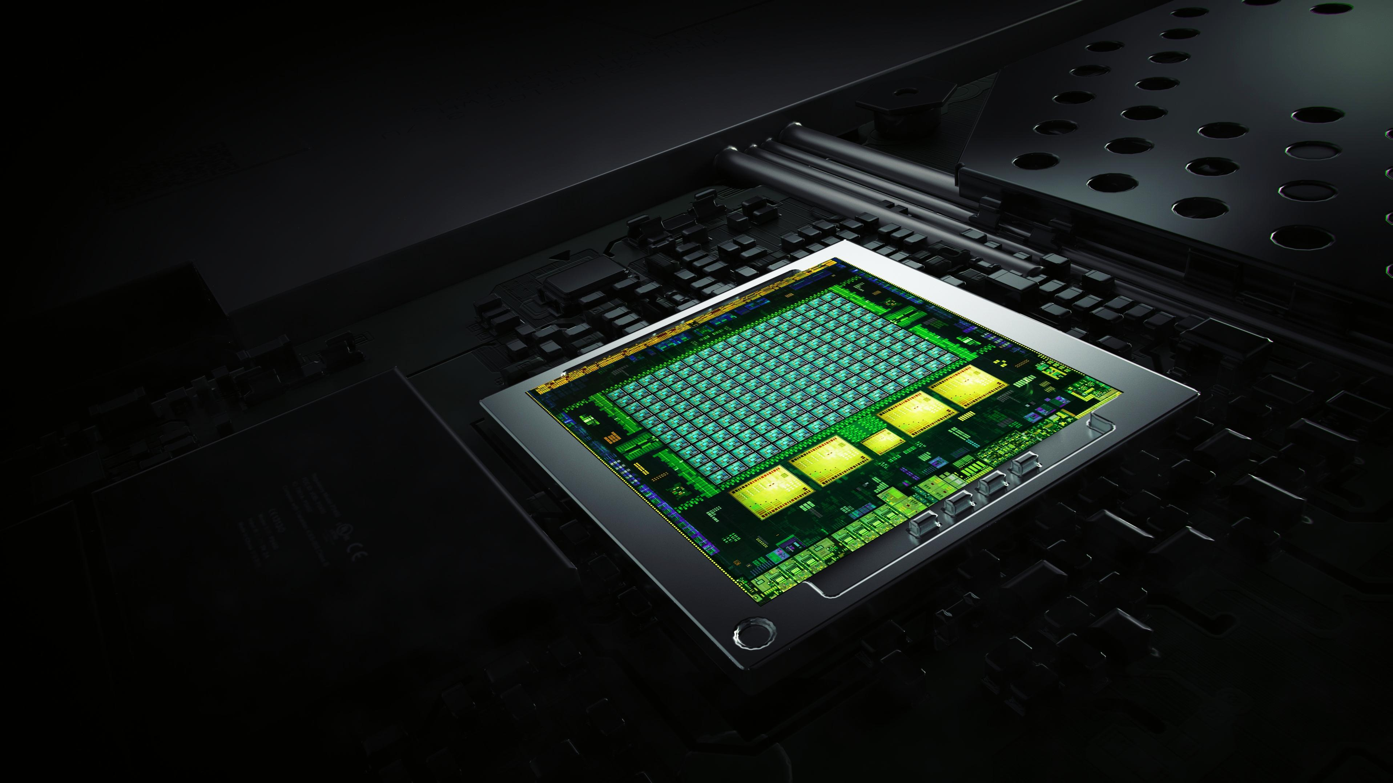
Tegra K1
Impossibly advanced
NVIDIA Kepler Architecture
4-Plus-1 Quad-Core A15
192 NVIDIA CUDA Cores
Over 300 GFLOPS
5 Watts
Notes:
Introduced at CES 2014, Tegra K1, a 192-core super chip, brings the heart of GeForce and the soul of Tesla to mobile.
It’s based on the Kepler architecture, which powers the world’s fastest GPU, GeForce GTX 780 Ti, as well as the Titan supercomputer at Oak Ridge National Labs.
With 192 fully programmable processor cores, Tegra K1 bridges the gap for developers, who can now build next-gen games and apps that will run on any device.

Slide 7
Jetson TK1 Block Diagram
JETSON TK1 BLOCK DIAGRAM
USB 2.0 micro B
Tegra K1
SOC
HDMI
USB 3.0
A
SATA
A15
GK20A
192 CUDA Cores
A15
Mini PCIe x1
A15
ALC5639 Audio Codec
Headphone Out
A15
GigE
RTL8111GS PEX - GigE
Arm7
MIC In
ISP
Audio
HD Video
JTAG
SD/MMC
2 GB
DDR3L
16 GB eMMC
Expansion Port (DP/LVDS, Touch SPI, I2C, CSI x1, CSI x4, GPIO 6:0)
AS3722
PMIC
Notes:
This block diagram shows the overall system architecture of the Jetson TK1
The CPU portion of the Tegra K1 consists of 4 ARM A15 CPUs and 1 ARM battery saver CPU core
The GPU consists of 192 CUDA cores
There is a single USB 3.0 port which is connected to the USB hub on Jet (the hub is used to connect to the Arduino Mega and the camera)
The micro USB port is used for flashing the OS during initial configuration
During normal operation, the micro USB port is not used

Slide 8
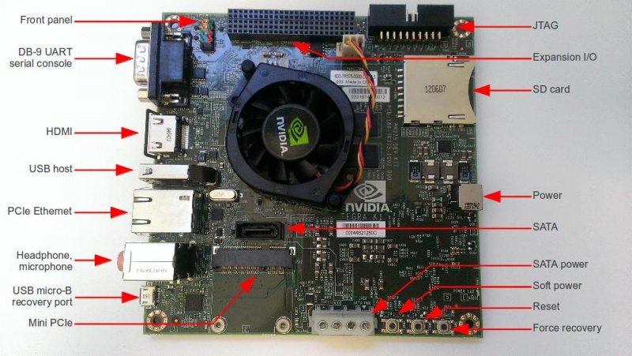
Pinout Diagrams Courtesy of Corneliusz Jarzebski
Notes:
This is a photograph of the TK1 and you can see the USB host port on the left and the micro USB port as well
The soft power button is used to turn on the board and to power down the board, hold down the soft power for 1 second and that will initiate a shutdown
The power jack is on the right side of the board
The Mini-PCIe socket holds the wireless adapter card
A laptop can be connected directly to the TK1 using a crossover ethernet cable
A keyboard and monitor can be connected to the board if necessary, but one the TK1 is configured the system can be run as a headless system

Slide 9
TX1/TK1 Development Environment
Code will be developed in C++
Initial configuration of the board is done using a python setup script
docs/setup_jetson.py
Detailed instructions in the lab assignment to build Jet
You can enter code using any standard Unix editor
The files will be saved to the built-in flash
You do not need to add an external memory card
After the system has been configured correctly, relevant source code can be found in the ‘rosjetson’ directory
Notes:
Code that is developed for Jet will be written in C++ and built using the ROS development environment
Initial configuration of the board is done using a python setup script that flashes the operating system and downloads all the relevant packages
You can use any standard Unix editor to type in the code, it is not dependent on any IDE
Once the system has been correctly configured using the installation script, the ROS files can be stored in the ‘rosjetson’ directory

Slide 10
Connecting to the TX1/TK1 Remotely
Use ssh to connect to the TX1/TK1 for a command line interface
Use VNC to connect with a GUI interface
Notes:
Using ssh, you can remote shell into the TK1 and this will allow remote command line access
Using a VNC client, you can connect to the device and have a graphical display

Slide 11

The GPU Teaching Kit is licensed by NVIDIA and California Polytechnic State University under the Creative Commons Attribution-NonCommercial 4.0 International License.

